Slide 1
ARCHETECTURE SOLUTIONS
E-commerce Front End
Marlin’s Charters

Slide 2
CONCEPT
Marlin’s Charters is a charter boat service located in Destin, Florida. The fleet consists of 4 boats
Joe Marlin has contacted me to help design and implement a front-end commerce cloud solution in Microsoft Azure for making reservations. At present, he books all clients through e-mail. However, there are times when he double books or turns away clients when a spot is open. An e-commerce website will enable him to maximize bookings and even expand his offerings. As a small business he wants to keep his cost low.

Slide 3
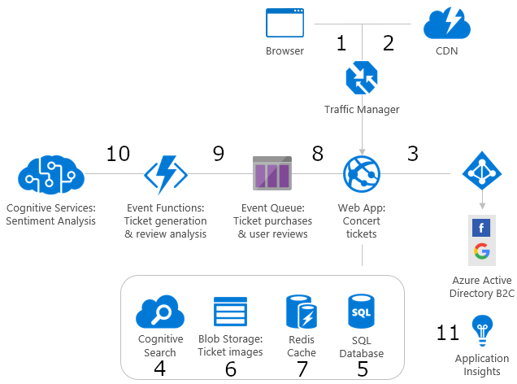
Marlin’s Charter Service
Serves up static web images and content
Originates request
Routes request to site for the closest regional delivery of content
Provides analysis to determine negative or positive review sentiment
Sign in and authenticate (business to customer)
Processes orders and reviews
Ques requests (improve performance)
For continuous monitoring and increased performance
Application (web app) allows user to search for open dates, pulls details, saves the reservation(after deposit), and then the query results are cached for better performance.
Note: Expansion will include the ability to order food, amenities, and information pushes for upcoming specials.

